Slide 1

Instamap
Team John Hall

Slide 2
Introduction

Slide 3
Introduction
The purpose of this project is to gain insights into the Instagram posts across Singapore based on:
The estimated post density in each location
The estimated post favorability in each location

Slide 4
Introduction
Web Interactive Map
(More Information)
Instagram Posts
3D Printed Map
(Easier Visualization)

Slide 5
Data Collection

Slide 6
45000 Posts
From 60000 posts

Slide 7
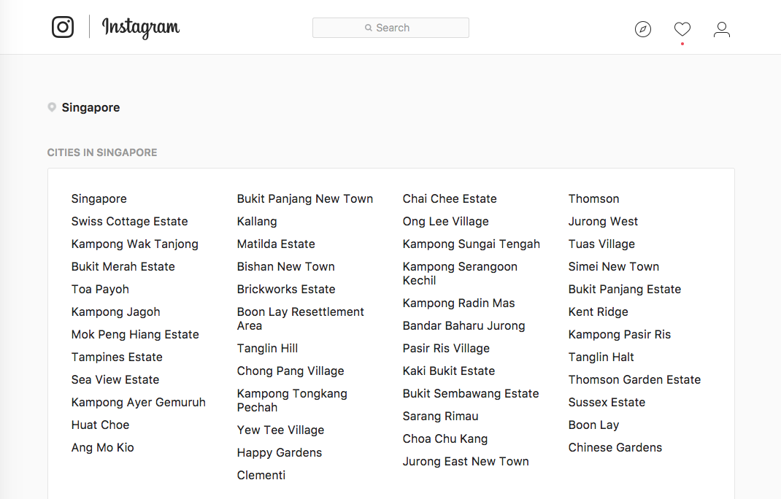
Get Location IDs
https://www.instagram.com/explore/locations/SG/singapore/

Slide 8
Instagram PHP Crawler
Using: https://github.com/smochin/instagram-php-crawler
Input: location ID
Output: Media information of 12 most recent post
Media code (media identifier)
Date/Time posted

Slide 9
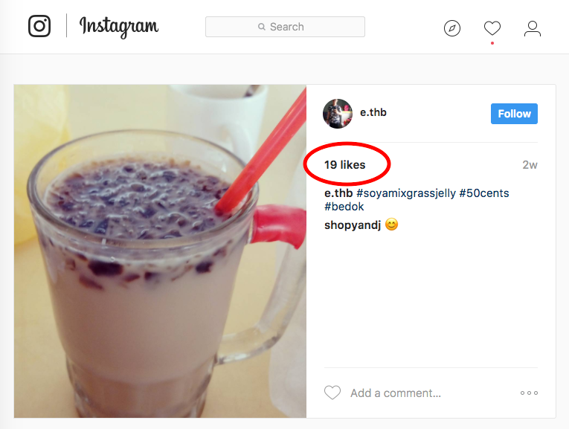
Get Number of Likes
https://www.instagram.com/p/<media_code>

Slide 10
Geocoding
Using: http://www.freegeocoding.com/uploadindex.php
Input: Location Name
Output: Geolocation of the location
Latitude
Longtitude

Slide 11
Data Analyzation

Slide 12
Data Analyzation
Location ID | Latitude | Longitude | # Likes | Time | Time Interval
A | Lat A | Long A | 3 | Time A1 | Mean_interval (All)
A | Lat A | Long A | 2 | Time A2 | Time A2 - Time A1
B | Lat B | Long B | 2 | Time B | Mean_interval (All)
group by Location ID
Number of post per location
Number of like per post per location
Location ID | Latitude | Longitude | # Likes | Time Interval (hr)
A | Lat A | Long A | 2.5 | Mean_interval (A)
B | Lat B | Long B | 2 | Mean_interval (B)
Plot
Mean
Median

Slide 13
Web Interactive Map Demo

Slide 14
3D Printed Map Demo

